Slide 1
SLAM with Objects using a Nonparametric Pose Graph
Beipeng Mu, Shih-Yuan Liu, Liam Paull, John Leonard, onathan P. How
IROS 2016
Probabilistic Data Association for Semantic SLAM
Sean L. Bowman, Nikolay Atanasov, Kostas Daniilidis, George J. Papas
ICRA 2017
Sher and Alon

Slide 2
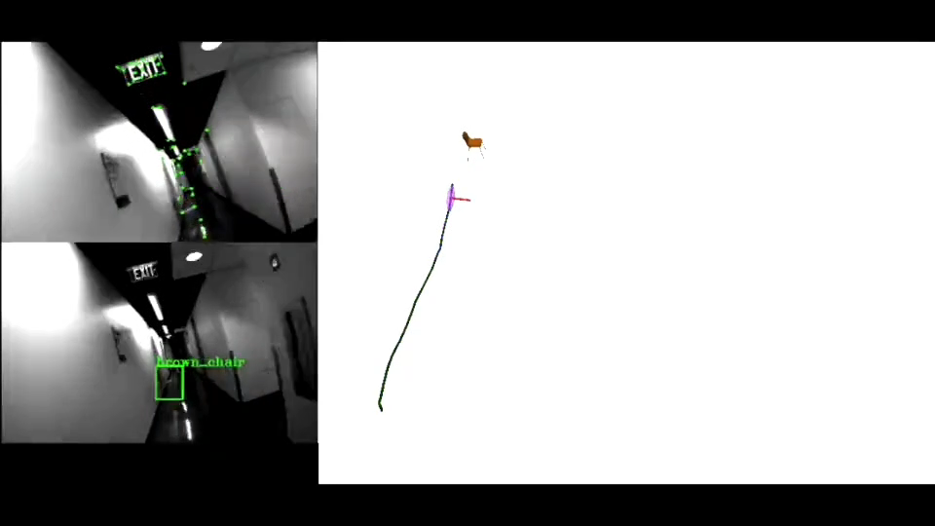
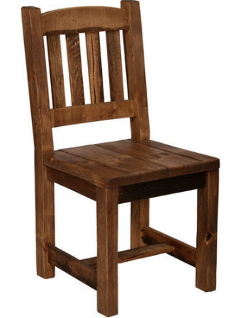
Landmarks
Geometrical Feature:
-Location
-Descriptor
Semantic Feature:
-Location
-Class
Probabilistic Data Association for Semantic SLAM
ICRA 2017

Slide 3
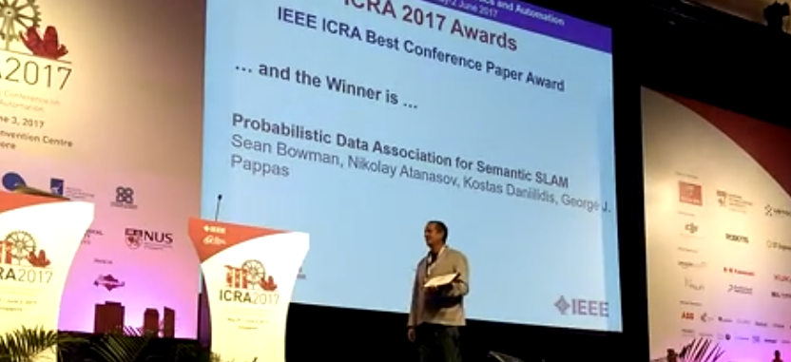

Slide 4
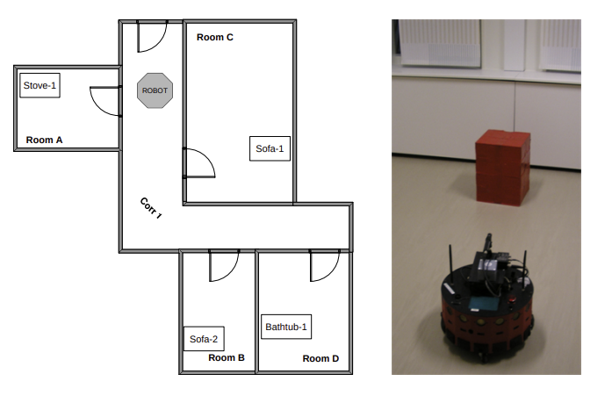
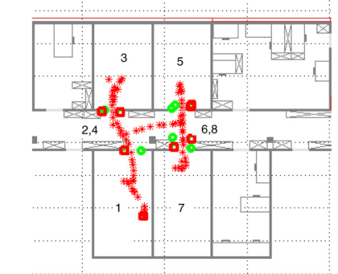
2005
‘We are interested in semantic information, which gives meaning to spatial information like images or geometric maps’
Semantics is preferred/required
Object recognition required
2005: Multi-Hierarchical Semantic Maps for Mobile Robotics
Correct data association is imperative to avoid false positives.
Position belief of an object from multiple measurements of it must be addressed
2007
2007: Cognitive maps for mobile robots—an object based approach
Notes:
2005: Multi-Hierarchical Semantic Maps for Mobile Robotics: LRF + color camera for object recognition. Maps the walls, does not localize the objects themselves beside ‘being in a room’
2007: Cognitive maps for mobile robots—an object based approach: LRF + stereo. SIFT for door detection

Slide 5
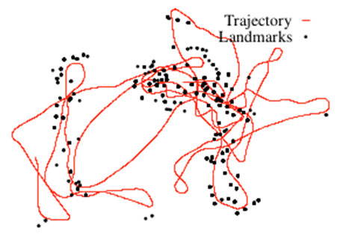
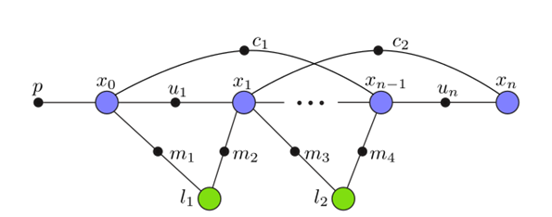

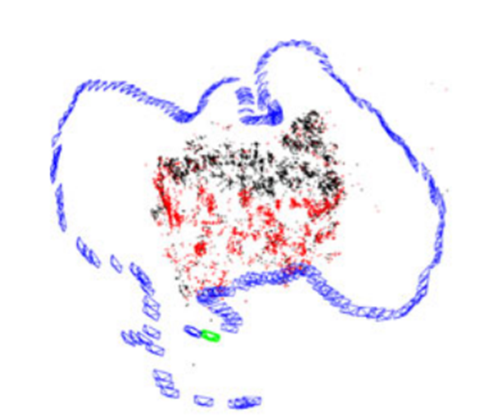
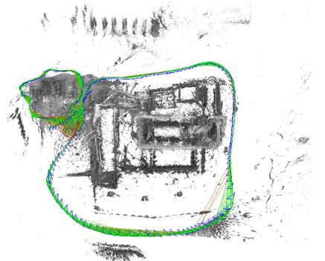
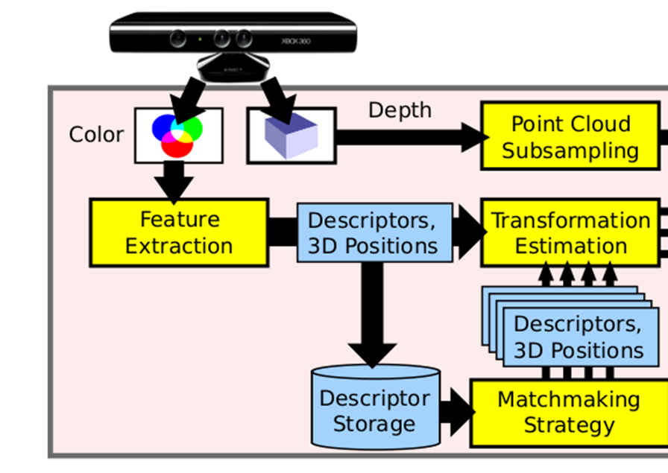
2011
When did the community start working on Semantic Slam
Graph Optimization Toolboxes
2013
Kalman Filter Semantic SLAM
2010: ceres
2011: g2o
2012: ISAM2
2014
Geometrical SLAMS with graph optimization
2016
Semantic Slams
With graph optimization
2015: ORB-SLAM
2014: 3D Mapping with an RGB-D Camera
2014: LSD-SLAM

Slide 6
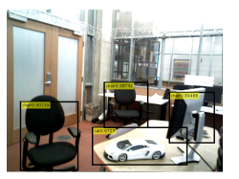
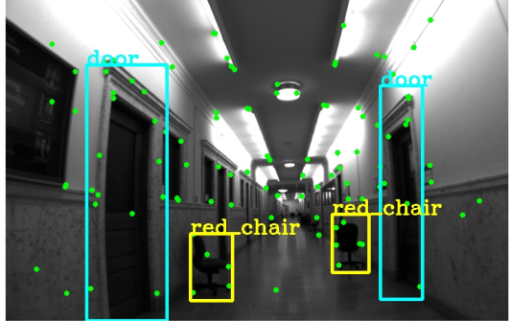
2011
When did the community start working on Semantic Slam
Graph Optimization Toolboxes
2013
2011: g2o
Kalman Filter Semantic SLAM
2012: ISAM2
2014
2014: 3D Mapping with an RGB-D Camera
Geometrical SLAMS with graph optimization
2014: LSD-SLAM
2015: ORB-SLAM
2016
Semantic Slams
With graph optimization
2016: SLAM with Objects using a Nonparamteric Pose Graph
2017: Probabilistic Data Association for Semantic SLAM

Slide 7
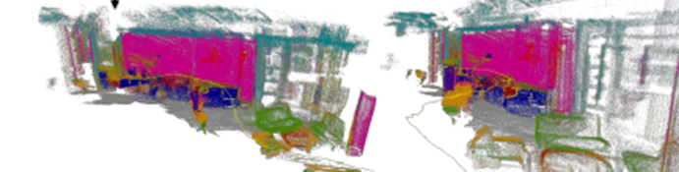
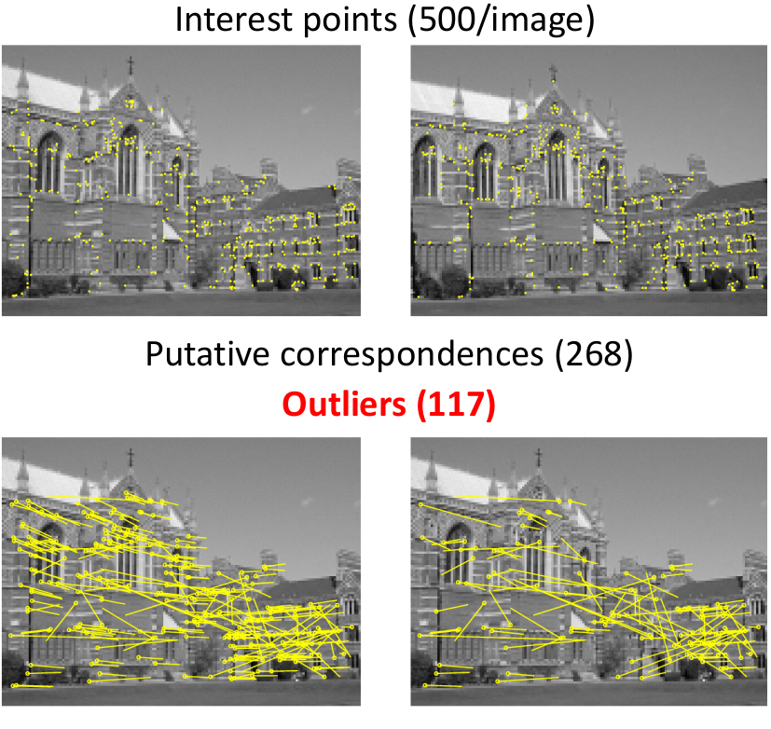
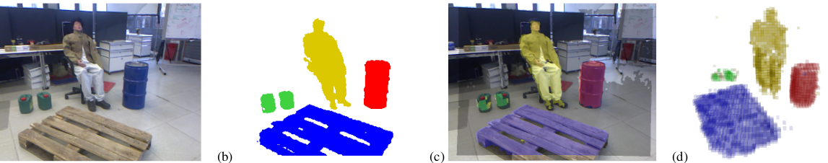
2014: Dense 3D Semantic Mapping of Indoor Scenes from RGB-D Image
2012: Semantic Mapping Using Object-Class
Segmentation of RGB-D Images

Slide 8
2011
When did the community start working on Semantic Slam
Graph Optimization Toolboxes
2013
Computer vision outburst
YOLO ARTICLE
2016
Semantic Slams
With graph optimization
2016: SLAM with Objects using a Nonparamteric Pose Graph
2017: Probabilistic Data Association for Semantic SLAM

Slide 9
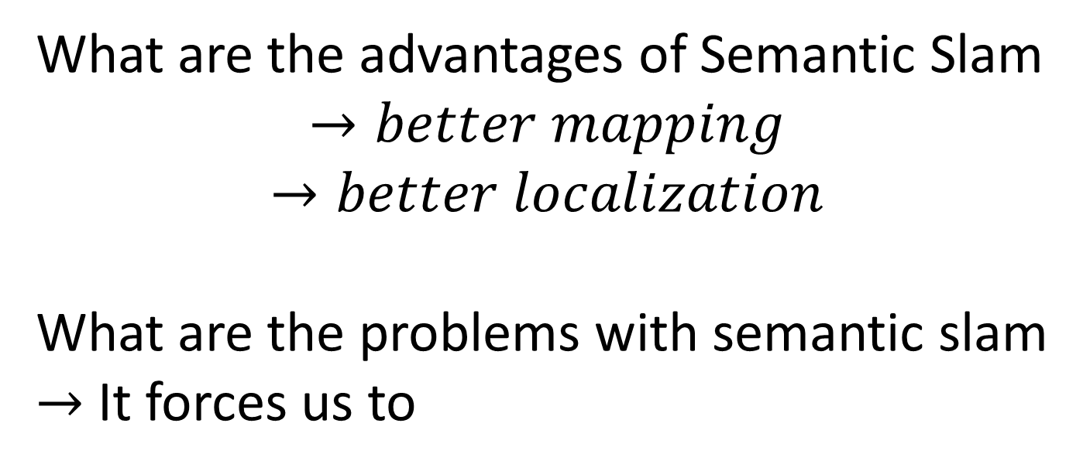
What are the advantages of Semantic Slam
$$→better mapping$$
$$→better localization$$
What are the problems with semantic slam
$→$ It forces us to

Slide 10
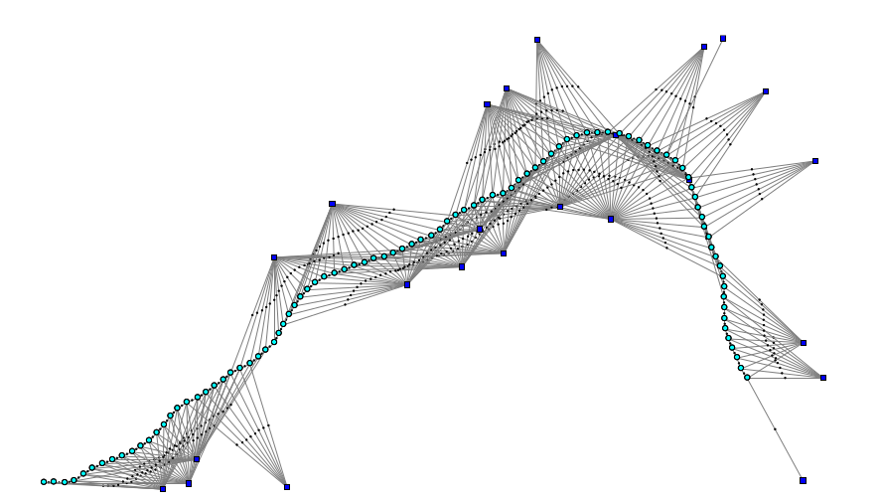

Geometrical Pose Slam Optimization Problem
Landmarks
Measurement
Poses
Odometry

Slide 11
What are the advantages and challenges of semantic SLAM
Geometrical Pose Slam Optimization Problem
Landmarks
Measurement
Poses
Odometry

Slide 12
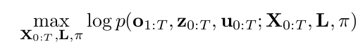
What are the advantages and challenges of semantic SLAM
Semantic Pose Slam Optimization Problem
Landmark Classes
Landmarks Positions
Geometrical Measurement
Pose
Class measurement
Odometry

Slide 13
Geometrical
State With Measurements
Semantic
Slam optimization - backend

Slide 14
Main Contribution
Point 1
point2

Slide 15
METHOD

Slide 16
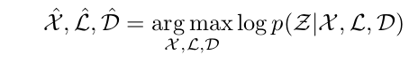
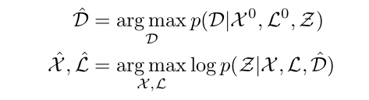

Slide 17
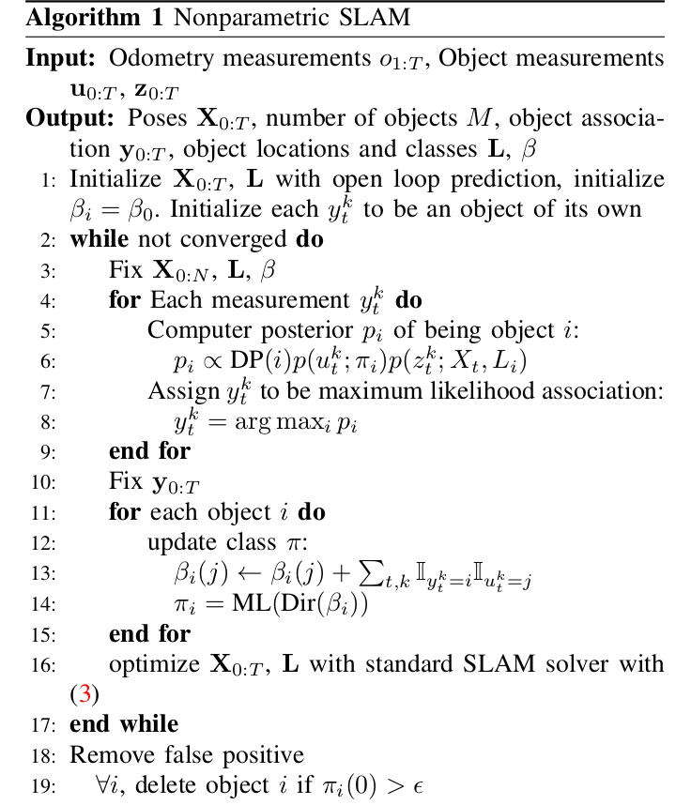

Slide 18
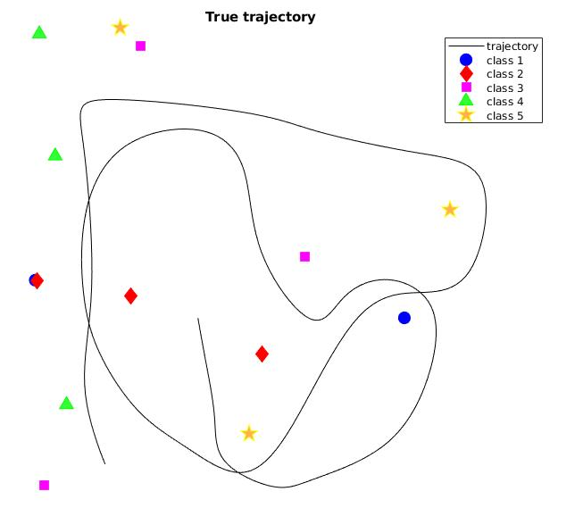
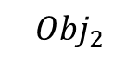
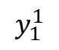
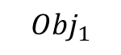
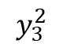
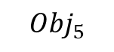
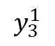
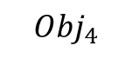
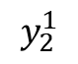
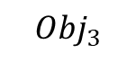
Ground Truth
$${Obj}_{4}$$
$$y_{3}^{2}$$
$${Obj}_{3}$$
8 objects
M objects
$$y_{3}^{1}$$
$${Obj}_{2}$$
$$y_{2}^{1}$$
$$y_{1}^{1}$$
$${Obj}_{1}$$
$${Obj}_{5}$$

Slide 19
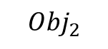

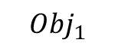
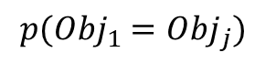
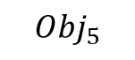

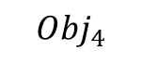

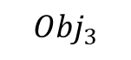
$${Obj}_{4}$$
$${Obj}_{3}$$
$${Obj}_{2}$$
$${Obj}_{1}$$
$${Obj}_{5}$$
$$p\left(u_{t}^{k} | π_{i}\right)p\left(z_{t}^{k} | X_{t},L_{i}\right)=f\left(class\right)∗f(space)$$
$$p({Obj}_{1}={Obj}_{j})$$
$$2$$
$$3$$
$$4$$

Slide 20
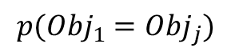
$${Obj}_{4}$$
$${Obj}_{3}$$
$${Obj}_{2}$$
$${Obj}_{1}$$
$${Obj}_{5}$$
$$p\left(u_{t}^{k} | π_{i}\right)p\left(z_{t}^{k} | X_{t},L_{i}\right)=f\left(class\right)∗f(space)$$
$$p({Obj}_{1}={Obj}_{j})$$
$$2$$
$$3$$
$$4$$

Slide 22
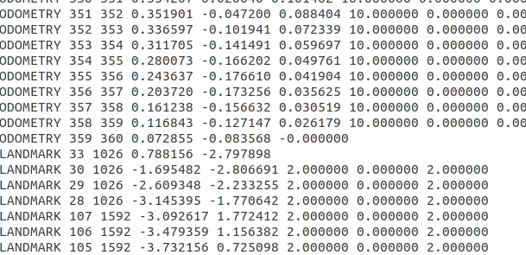

Slide 25
Experiment

Slide 26
Our Simulation

Slide 27
Conclusions

